Slide 1
Summary REPORT
Team 21:
Honey Jain
Samarthan Bothra
Saloni Bhandari

Slide 2
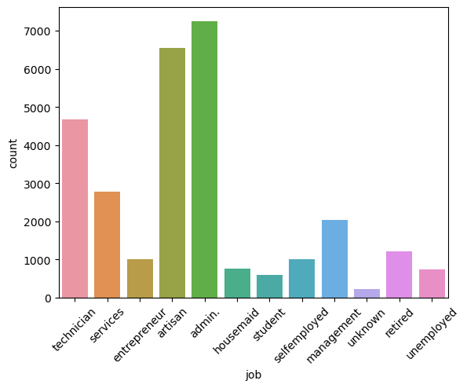
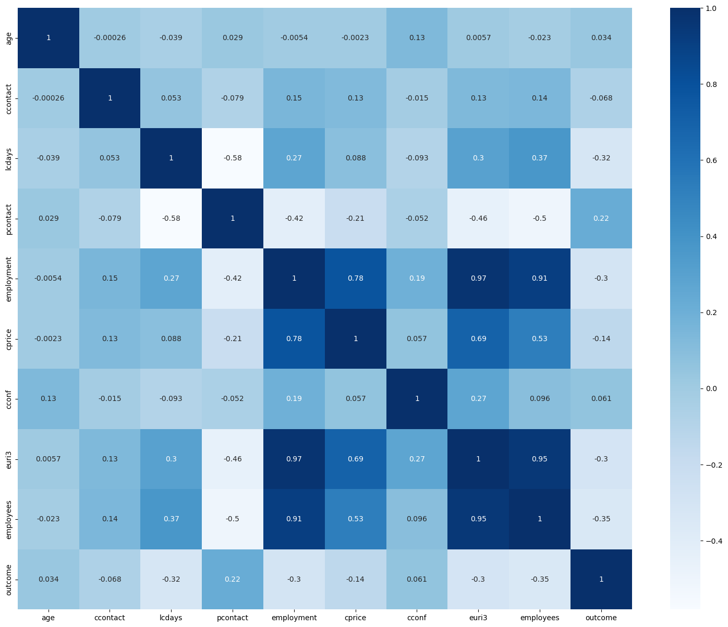
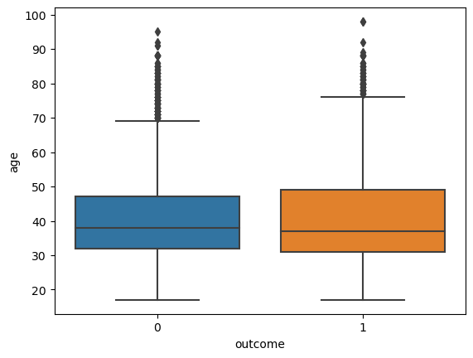
Data Understanding
The train and test datasets were loaded and analyzed. The distribution of the target variable 'outcome' was visualized using a count plot. The correlation between numerical variables was plotted using a heatmap. The distribution of the age variable by the outcome was visualized using a boxplot. The distribution of the job variable was visualized using a count plot. The distribution of the age variable was visualized using a histogram.

Slide 3
Data Preparation
The 'id' variable was removed from both the train and test datasets.
Missing values were filled with the median and mode values.
Categorical variables are one-hot encoded using the function 'encode_data', which creates a new binary variable for each unique value in the categorical variable.
The predictor variables 'X' and 'test_data' are split into train and test sets using the 'train_test_split' function from the 'sklearn.model_selection' module.
The split is done with a test size of 25% and a random state of 4, which ensures that the same split is obtained each time the code is run.

Slide 4
Modelling
The model used in this code is a random forest classifier from scikit-learn library. It is a decision tree-based ensemble algorithm that can handle both categorical and numerical features.
A random forest classifier was used to predict the target variable. The hyperparameters were tuned using RandomizedSearchCV.
The chosen hyperparameters were n_estimators=35, max_depth=10, criterion='entropy', min_samples_leaf=3, max_features=15, and min_samples_split=3. A class weight of {0: 0.8, 1: 3.0} was used to account for class imbalance.
The predicted probabilities of the model are obtained on the test data using the predict_proba method, which returns the probabilities of the positive class. The probability threshold for classification is set to 0.5.

Slide 5
Evaluation Methodology
I have used several metrics such as roc_auc_score, accuracy_score classification_report, roc_curve, and AUC, to evaluate the performance of the models.
RandomForestClassifier is evaluated using roc_auc_score, which is the area under the receiver operating characteristic curve (ROC AUC), and printed to the console.
Furthermore, I have predicted the test data using the trained model and saved the results in a CSV file

Slide 6
Managerial Implications
The results of the models can be used to predict the likelihood of someone opening a savings account. The RandomForestClassifier model achieved a test AUC of 0.802, indicating that it can predict the outcome variable reasonably well.
The managers can use the model to identify potential customers who are likely to open a savings account, target them with specific marketing campaigns, and increase the bank's revenue.
However, optimizing the hyperparameters or using more advanced machine learning techniques can improve the model's performance.

Slide 7
Thank You

